Slide 1
The Delaware Economic Impact of Offshore Wind
David T. Stevenson
Director, Center for Energy & Environment
Caesar Rodney Institute
9/8/2022

Slide 2
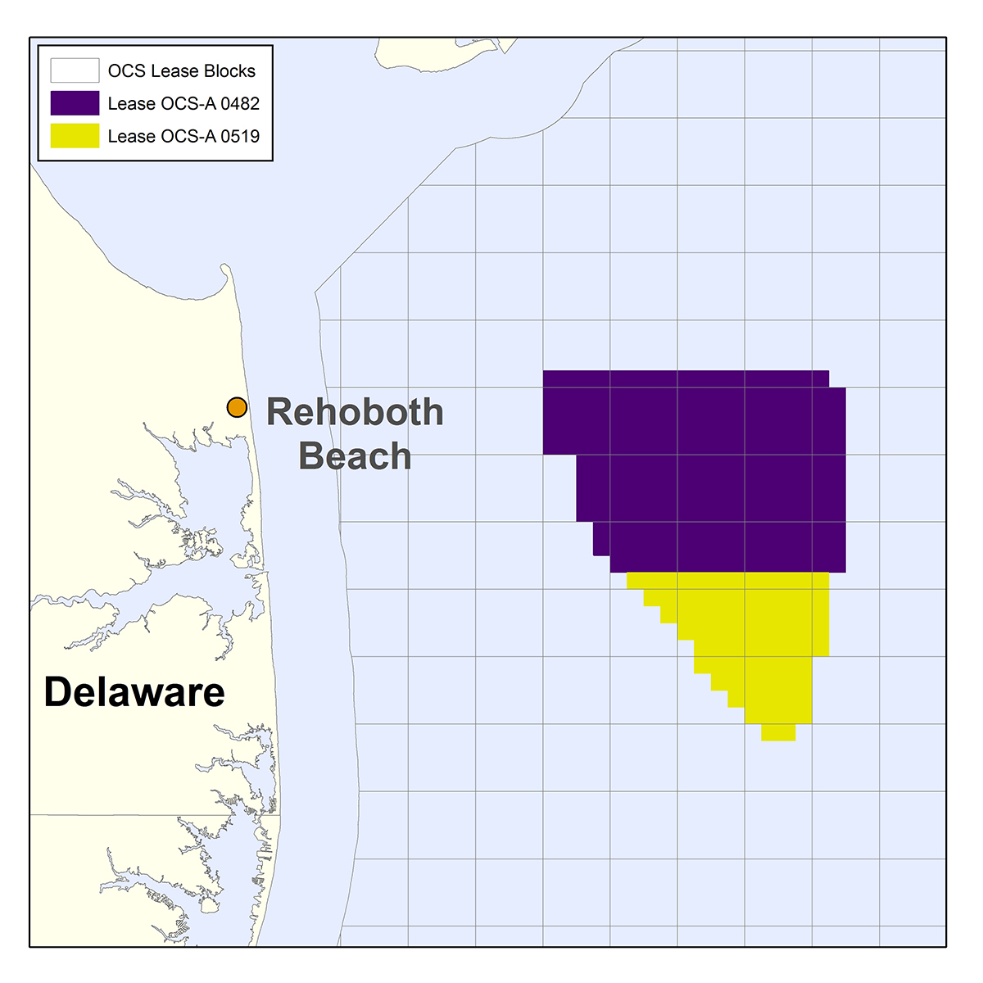
13 miles
Skip Jack 1& 2 = 966 MW, Garden State =1,200 MW, Total of 180 turbines as close as 13 miles

Slide 3
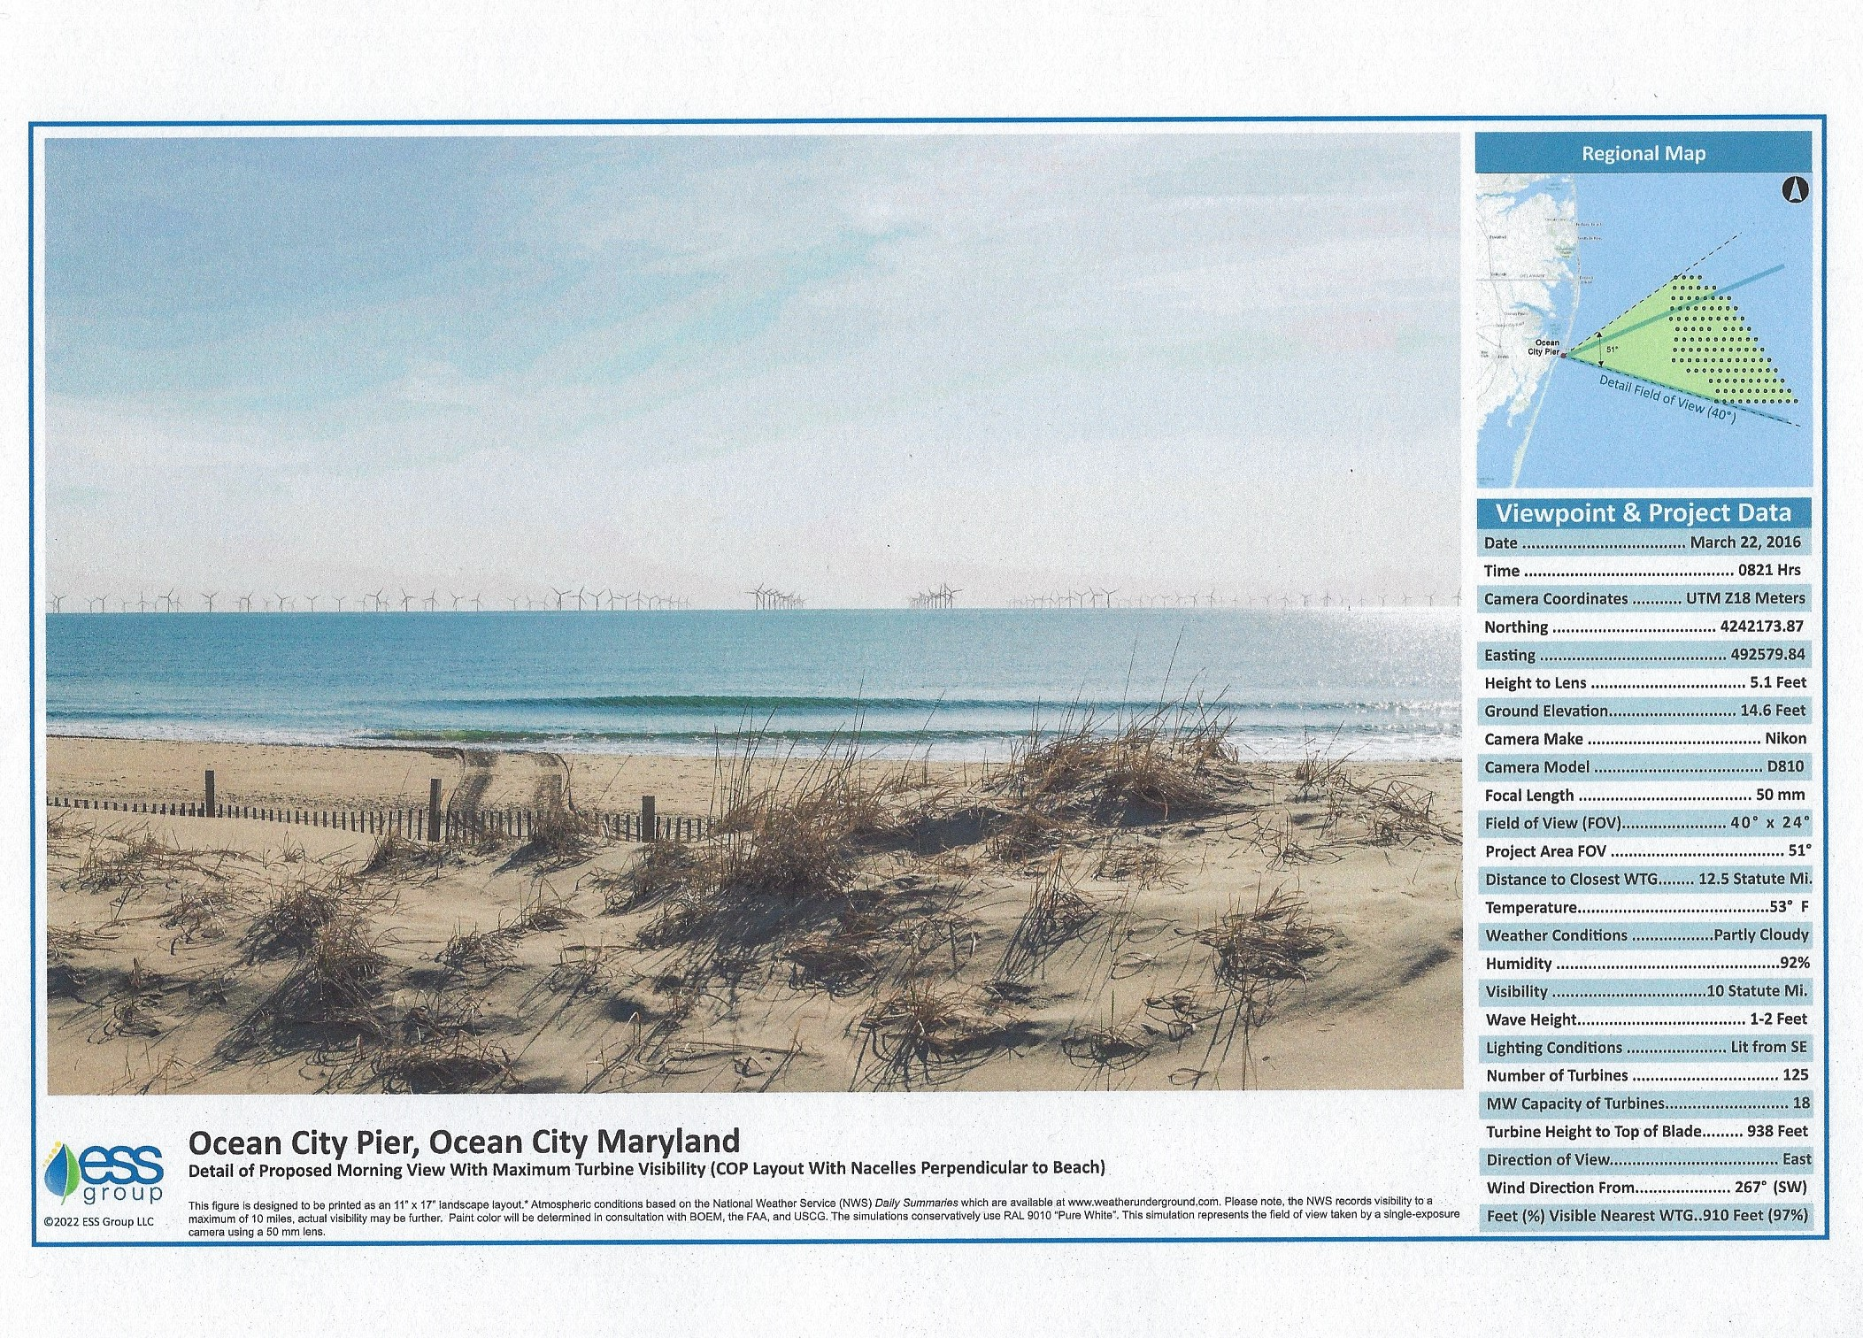
US Wind visualization at 12.5 miles off Ocean City, MD

Slide 4
Industrial wind project at night
Iowa project “visible for dozens of miles”

Slide 5
All the economic benefits of the Skipjack & Garden State projects are promised to MD & NJ as their electric customers will average $1.2 billion a year in electric premium subsidies for 20 years
Delaware will only see incidental job gains

Slide 6
Federal Environmental Statement on the Viewshed
The presence of offshore turbines would change perception of ocean scenes from natural and undeveloped to developed, and would be an unavoidable presence in views from the coastline (dominating) the view.
Two different consultants to the Maryland Public Service Commission noted offshore wind would simply replace onshore wind & solar
The US Energy Information Agency forecasts a 2027 lifetime cost of offshore wind at $136.51/MWh, solar at $36.49, onshore wind at $40.23. Advanced nuclear power & carbon capture are also viable alternatives at lower cost. In 2021 wholesale rates averaged $30/MWh

Slide 7
Potential Major Environmental Damage
Blades on each turbine cover 8 football fields with tips moving up to 180 MPH and will kill birds including the Endangered Red Knot, and Piping Plovers, and possibly endangered Monarch Butterflies and other migratory birds
Operational noise will likely exceed NOAA Level B marine mammal harassment levels by thousands of times impacting several endangered whale species – there is no existing comparable turbine
The projects are built atop the Carl N Shuster Jr. Horseshoe Crab Sanctuary with no testing of the impacts
Boat collisions will increase while Coast Guard search & rescue operations will be hampered potentially leading to deaths - BOEM

Slide 8
Delaware Negative Economic Impacts
A North Carolina State University study shows 38% of renters will not return to a beach with visible turbines, 54% when shown nighttime views
That’s $0.5 to $1 billion lost beach economy revenue per year
That equals 3,750 to 9,500 permanent job losses (think pandemic)
Old turbines may wind up in Delaware landfills

Slide 9
University of Delaware Visual Impact Study
Shows equal negative & positive comments at 15 miles with 579’ turbines
However, 938’ turbines are equivalent to survey results at 10 miles with 29% negative, 10% positive, yielding a net negative 19%
Nighttime views were shown but no data reported
Lost tourism will likely lower property values, but no data or impact forecast reported
One of the two authors of the study has stated the study is no longer applicable because of the increase in turbine size (March 2021 Delaware Today Magazine interview)

Slide 10
Economic impact of a DE subsidized project
UD/DNREC suggest DE mandate an 800 MW project similar to Skipjack 2
Creates about 857 temporary construction jobs, 25 permanent jobs
Possible 2,500 lost permanent jobs from $400 million higher electric rates
The UD study suggests electric rates would be similar to existing power plants
Study only considers first year cost ignoring 2% to 3%/year escalator, and Maryland project first year costs given in 2012 dollars
Residential electric rates may rise $423/year, up to tens of thousands for some businesses (2.9 Billion kilowatt-hours/year x $0.137/KWh premium cost of Skipjack 2)/ 11.3 billion KWh DE electric demand = $.036/KWh electric bill premium X 11,750 KWh/year residential usage = $423/year)

Slide 11
This is not a done deal
Delaware can deny permits to bring power ashore effectively stopping the projects
Federal project approvals have been met with numerous likely successful lawsuits with 5 lawsuits filed against the first approved project
Fenwick Island and four HOAs have passed resolutions seeking to create a 30 mile exclusion zone similar to NY and NC, more beach communities may do the same
While there is no current federal law allowing a swap for lease areas farther offshore, laws can be changed and leases 30 miles out will be available in the next year

Slide 12
Correcting myths
Nighttime flashing lights will be mitigated – The proposed adoption of Aircraft Lighting Detection Systems promise comes with a qualifier, “if commercially reasonable”. What is reasonable? Navigation lighting will still be visible
A Block Island, RI study of much smaller turbines showed tourism growth after turbines installed – The study only looked at Airbnb rentals from 2017 after installation compared to 2014 and found 19% growth. Airbnb reports a global increase of 400% over that time period. No 2015/16 data included to show a possible growth trend, no interviews with renters to determine offshore wind impact, and no other rental pathways considered. This is an unreliable study.

Slide 13
Conclusion
Any DE economic benefits from currently planned offshore wind will be incidental jobs
There are better alternatives to achieve state environmental objectives such as solar, onshore wind, advanced nuclear, and carbon capture
DE faces a very high risk from lost tourism, significantly higher electric rates to cover transmission upgrades and a Delaware supported project, being a dumping ground for old turbines, and unknown environmental impacts
Offshore wind is a bad idea for DE and requires active opposition by beach communities

